Slide 1
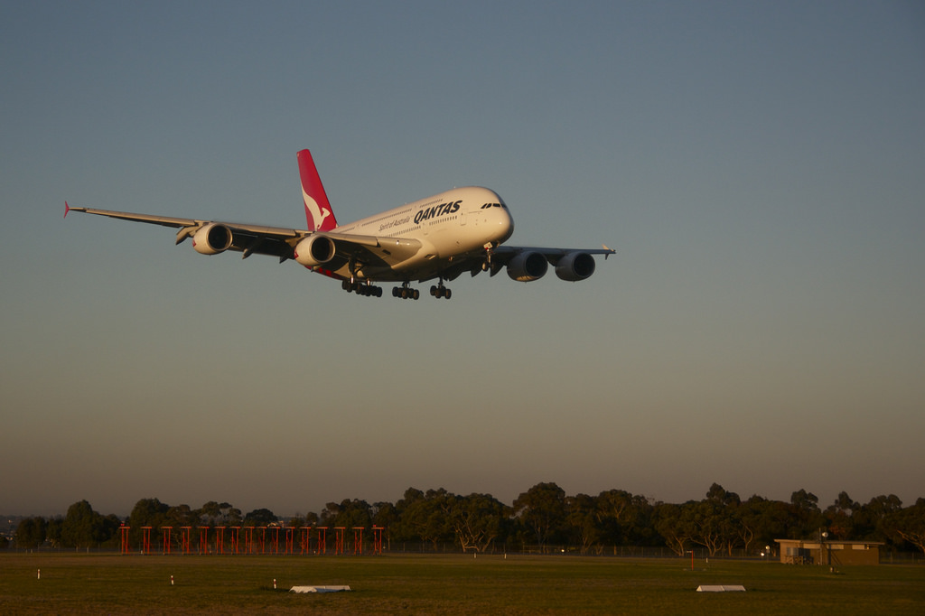
Etherisc
A look under the hood
8 February 2017

Slide 2
General architecture
User’s Browser
Oraclize
contract
FlightDelay
Meta
mask
FlightDelay JS + HTML
Frontend
Server
Notes:
(no long-term relations, coordination, independent deployment)

Slide 3
Deployment at DevCon2, Aug/Sept 2016
FlightDelay
Version 1
1 Contract
4.7M Gas
deploy
Aug. ‘16
contract
FlightDelay
Notes:
(no long-term relations, coordination, independent deployment)

Slide 4
Ethereum Attacks lead to decreased Block Gas Limit
FlightDelay
Version 1
1 Contract
4.7M Gas
deploy
Sept. ‘16
contract
FlightDelay
Notes:
(no long-term relations, coordination, independent deployment)

Slide 5
Ethereum Attacks lead to decreased Block Gas Limit
FlightDelay
Version 1
1 Contract
4.7M Gas
deploy
Sept. ‘16
contract
FlightDelay
Block Gas Limit
1 M Gas
Notes:
(no long-term relations, coordination, independent deployment)

Slide 6
Modularization
FlightDelay
Version 2
7 Contracts
max. 3M Gas
FlightDelay
Version 1
1 Contract
4.7M Gas
Notes:
(no long-term relations, coordination, independent deployment)

Slide 7
Modules can be deployed independently
FlightDelay
Version 2
7 Contracts
max. 3M Gas
deploy
Jan. ‘17
contract
FlightDelay
Block Gas Limit
4.0M Gas
Notes:
(no long-term relations, coordination, independent deployment)

Slide 8
FlightDelay contracts
User
New Policy
Underwrite
Payout
Ledger = holding Funds
Access Control
Database
Controller = Contract registry

Slide 9
Further Prospects
Standardizing call relationships between contracts
Standardizing state model
Implementing business process engine
Security audits
Bug bountys

Slide 10
And one more ...

Slide 11

And one more ...

Slide 12
Etherisc
Decentralized insurance applications

